Slide 1
PROVING THE PAGES
Proving the New Testament

Slide 2
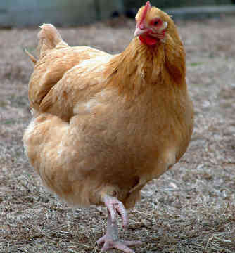
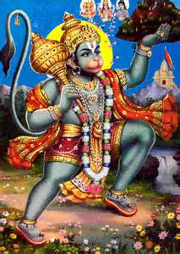
FEELINGS
VS.
FACTS

Slide 3
VOCAB
Subjectivism
FEELINGS = PROOF
Addict prays to…
Jesus
Hindu Monkey God
A tree

Slide 4
Is SALVATION a HEART issue?
Jeremiah 17:9-10
Proverbs 21:2
Psalm 51:10
Romans 10:10
Matthew 5:8

Slide 5
WHAT IS FAITH?
acts
ctions
ndividual
rust
ope
F
A I T H

Slide 6
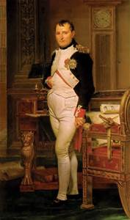
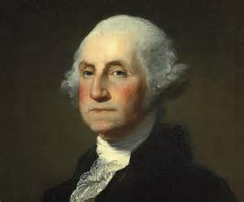
Christianity Is…
A space-time religion
A historical religion
A researched & recorded religion
An eyewitness religion
A contextual religion

Slide 7
The Bible Is…
God’s Word
Inspired
Factual
A History Book
Eyewitness Testimony
Accurate

Slide 8
What We’re Doing Here
There is ABUNDANT evidence from historical sources which is adequate to prove that Jesus is the Son of God and the Bible is the Word of God!

Slide 9
What We’re Doing Here
METHODOLOGY
Establish historical reliability of the New Testament
Reason evidences to conclude Jesus is the Son & the Bible the Word of God!

Slide 10
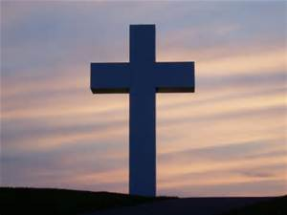
WHERE DO WE START?!?!?!

Slide 11
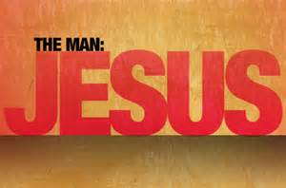
Arguments Against Jesus’ Existence
No first century secular evidence
NT writers seem ignorant of the details or Jesus’ life
NT accounts aren’t firsthand
Gospels contradict each other
Modern scholars find wildly different accounts of who Jesus was
WHAT DO WE DO WITH THIS?!?!?!

Slide 12
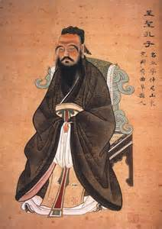
Why it’s different…
Christianity is based, relies on, & is validated by one thing:
the death, burial, & resurrection of Jesus Christ!

Slide 13
What We’ll Look At…
Non-Biblical Sources
Pagan (Gentile)
Jewish
Archaeology
Manuscript Comparison & Attestation
Length Between
Copying Methods
Apostolic Fathers’ Historic Testimony

Slide 14
What We’ll Look At…
The Resurrection
Pentecost
Apostles’ Testimony
Saul of Tarsus
Miracles
The Church itself

Slide 15
Two Goals
That YOUR faith may be strengthened in knowing the TRUTH!
If someone ever asks “How do you know what you believe is true…” you say “Let’s have a Bible study because there’s a TON of reasons why!!!!”

